Slide 1

HIDDEN WORD
- Guess the word with 5 letters
Each colour is a letter.
Choose the color and answer the question.
If the answer is correct, you’ll get a letter.

Slide 2

HIDDEN WORD
C
R
A
z
y
List 5 types of the house you know.
List 5 things in the bathroom.
List 5 things in the bedroom.
List 10 things in the livingroom.
List 5 things in the kitchen.

Slide 3
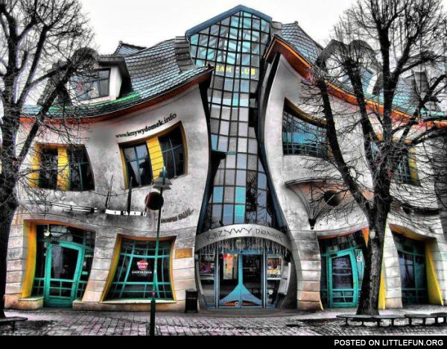
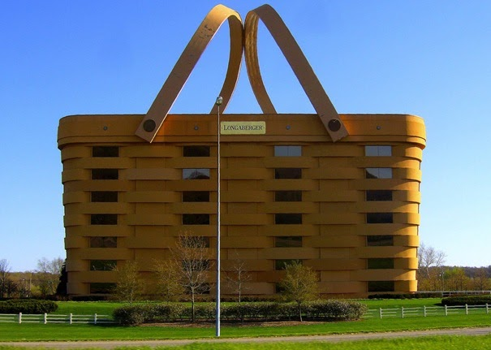

Slide 4

Period 13: Unit 2- MY HOME
Lesson 5: Skills 1

Slide 5
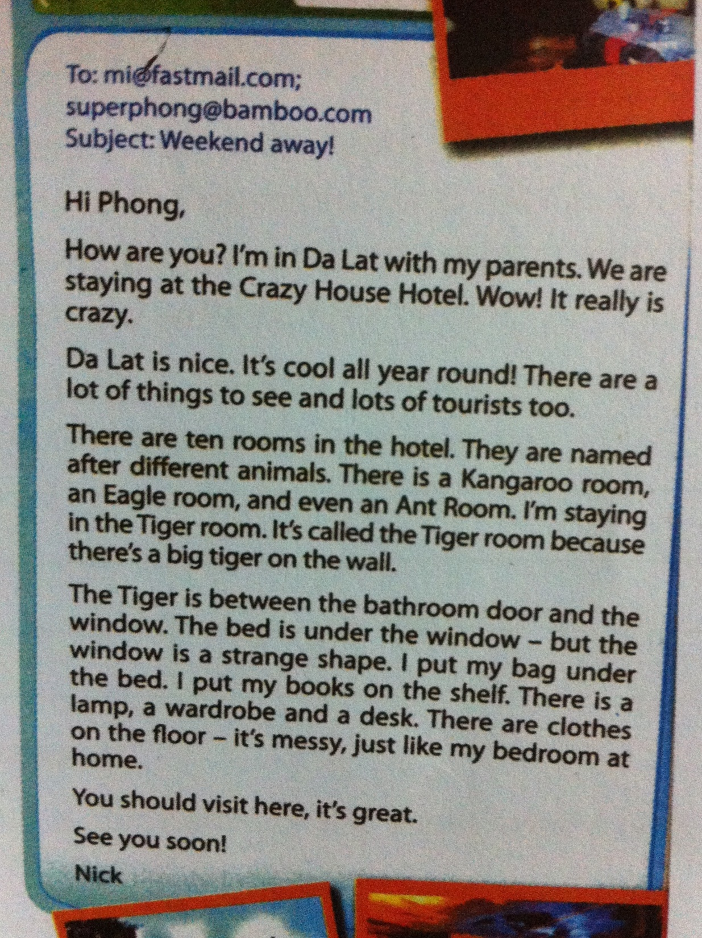
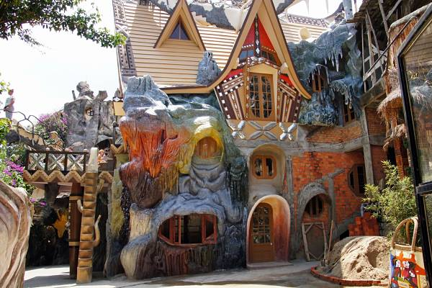
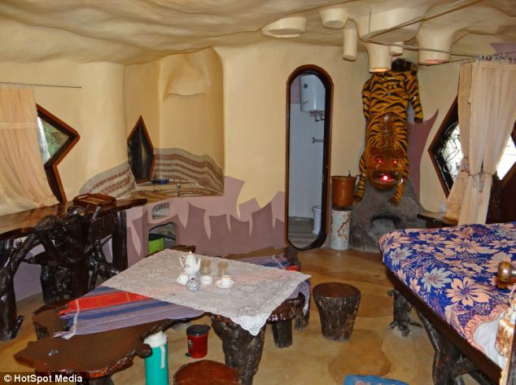
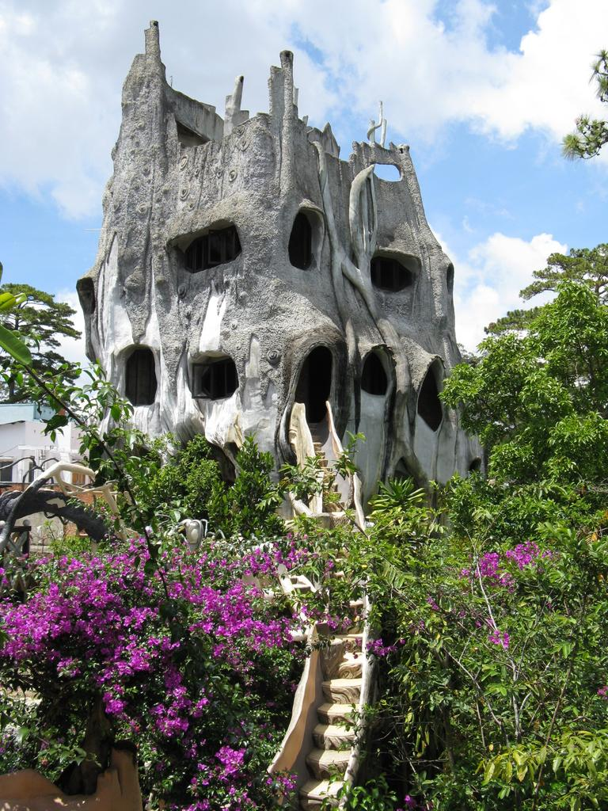

Slide 6


Reading
1. Look at the text. Answer the questions
What type of text is it?
2.What is the title of this?
3.What is the topic?
4.Write three things you know about Da Lat.
It is an email.
It is “ A room at the crazy hotel”.
It is “Nick’s weekend in Da lat”.

Slide 7
3. Read the text again and answer the questions
Is Nick with his brother and sister?
How many rooms are there in the hotel?
Why is the room called the Tiger room?
Where is his bag?
No, he isn’t.
There are ten rooms in the hotel.
Because there is a big tiger on the wall.
It is under the beg.

Slide 8
4. Are these things in the room ?
a window a sofa a cooker
a cupboard a shelf a lamp
a desk a poster a CD player a tiger

Slide 9

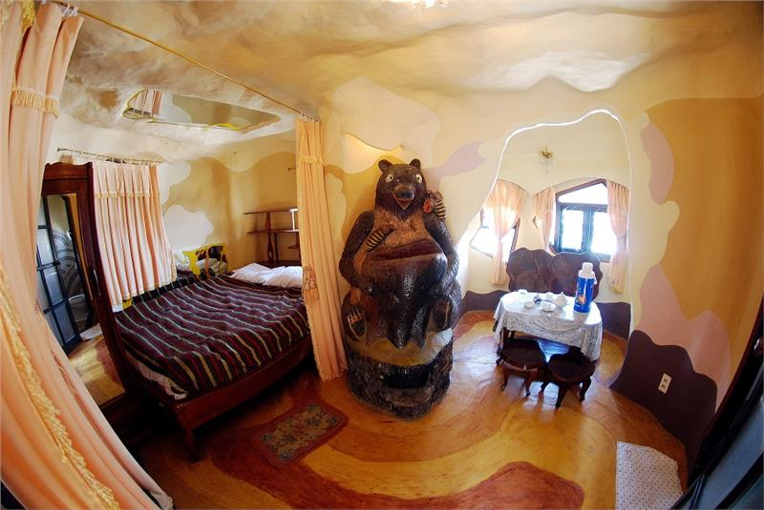
DISSCUSS ABOUT THIS CRAZY ROOM

Slide 10
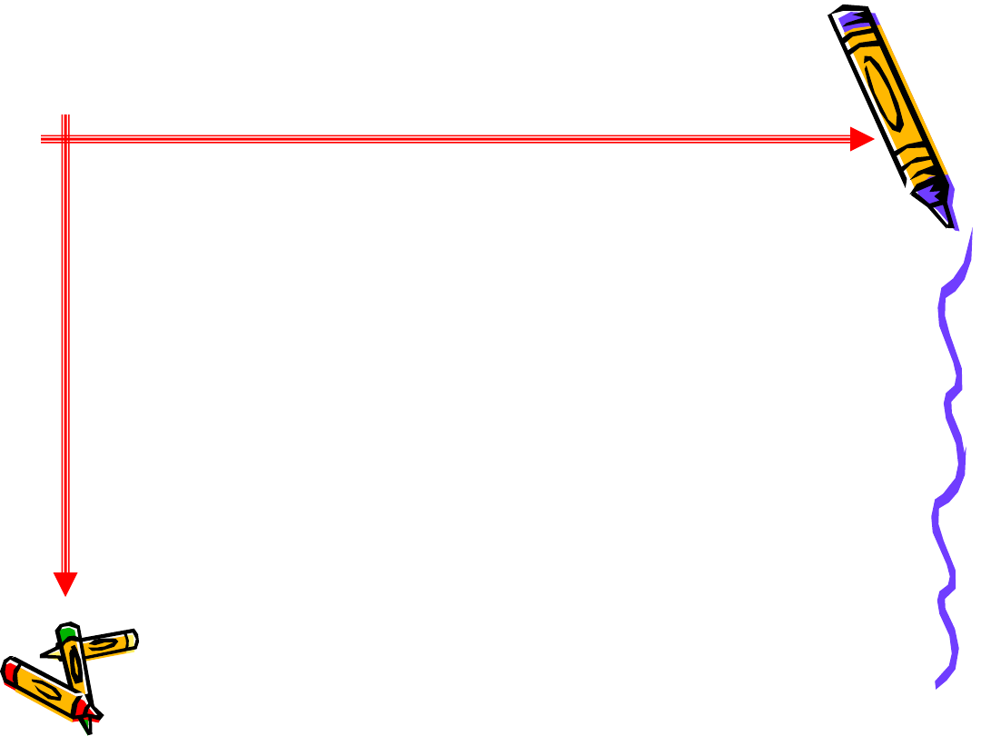
HOMEWORK
Do exercise in the workbook
Prepare well for new lessons ( Skill 2 )

